Slide 1
Danelaw II:
Assimilation
“Raiders to Traders”
Morgan Myers

Slide 2
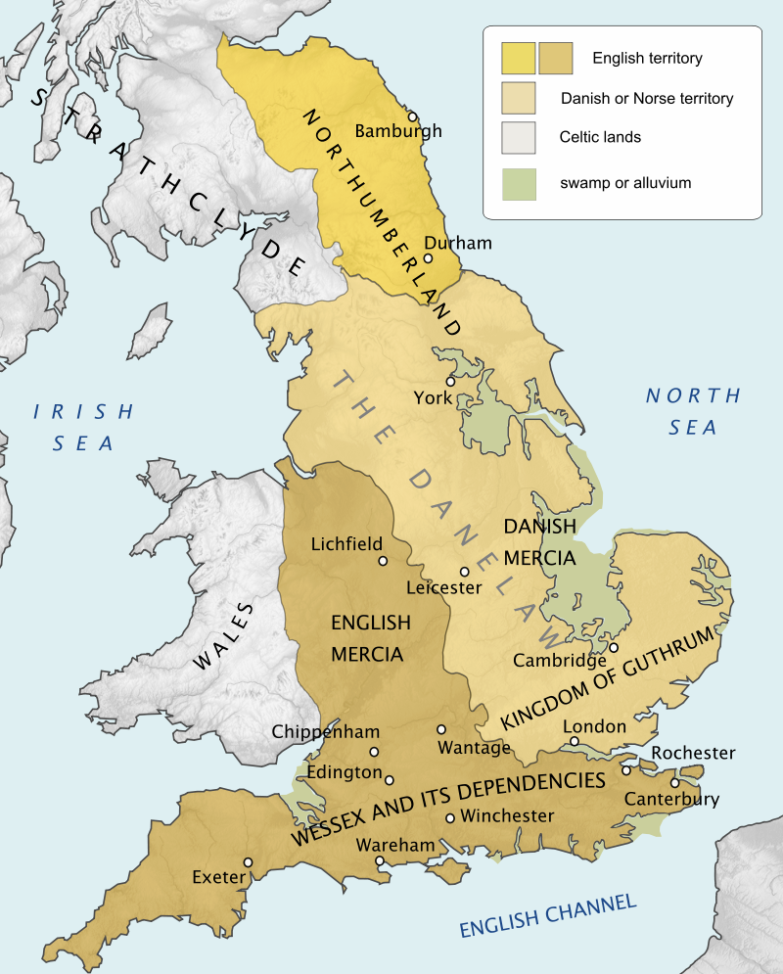
Danelaw is a term coined by Wulfstan, referring to a region of England where Scandinavian sociopolitical influence was strongest
Figure 1: Map of England 878¹

Slide 3
865 A.D.
Invasion of the Great Heathen Army
Reportedly led by three of Ragnar Lodbrok’s sons, most notably Ivar the Boneless
Capture Thetford, working up northwest to eventually capture York in late 866

Slide 5
899 A.D.
Death of Alfred the Great, succeeded by his son Edward the Elder
Aethelwold contests Edwards claim to the throne, allying with the East Anglian Danes and Viking Northumbrians

Slide 6
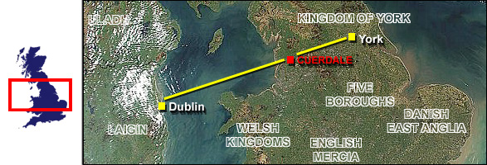
902 A.D.
Vikings driven out of Dublin by Cerball
Figure 2: Map of Viking path as they left Dublin, crossing Cuerdale²

Slide 7
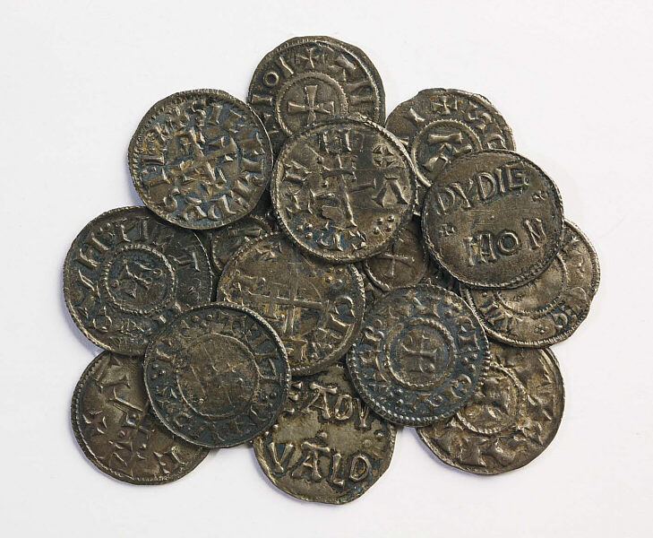
Figure 3a,b: Cuerdale hoard silver (left) and coins (right)—the latter of which dates the hoard to 905^{3a,b}

Slide 8
906 A.D
A shortlived peace agreement is reached between King Edward, and the East Angles/Northumbrians
Fully disintegrated by 910 A.D.
910-921 A.D
Burhs were built as a military protection for the English Villages

Slide 9
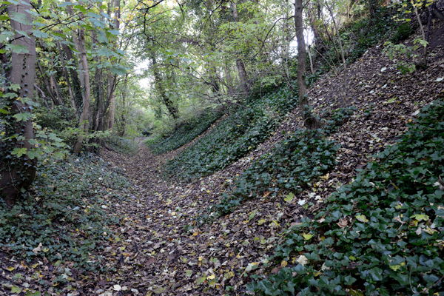
Figure 4a,b: A rendition of a Burh (left) and remaining burh wall (right), located in Wallingford, Oxfordshire^{4a,b}

Slide 10
911 A.D.
Ethelred, Lord of the Mercians, dies—succeeded by his wife Aethelflaed
917 A.D.
Northampton Vikings are repelled at Towcester, and East Anglian Vikings repelled at Bedford
In response, Edward’s forces retake Cambridgeshire, Huntingdonshire, Northamptonshire, and East Anglia

Slide 11
918 A.D.
Edward secures all England south of Mersey and Humber (west and east rivers)
920 A.D.
Aethelfled takes Leicester, York surrenders later in that year

Slide 12
924 A.D.
King Edward dies and is succeeded by his brother, Athelstan
926 A.D.
Athelstan directs Eadgyth to marry Sihtric of York—who undergoes a short-lived conversion to Christianity

Slide 13
927 A.D.
Sihtric dies, is nearly succeeded by his son Olaf, but is repelled by Athelstan

Slide 14
Figure 5: Silver from the Harrogate hoard⁵

Slide 15
934 A.D.
Constantine II, King of the Scots, challenges Athelstan’s goal of England’s unification under one king—allying with Olaf and Owen

Slide 16
937 A.D.
Athelstan and Edmund I battle Olaf, Owen and Constantine: The Battle of Brunanburh—”arguably one of the most significant battles [in the history] of the British Isles”
954 A.D.
Erik Bloodaxe dethroned—the last Scandinavian King of York

Slide 17
References:
1. https://en.wikipedia.org/wiki/Danelaw
2. http://www.yorkcoins.com/cuerdale_hoard.htm
3a. http://south-ribble.co.uk/srmuseum/pages/heritage/07_cuerdale_hoard/07_004.jpg
3b. https://upload.wikimedia.org/wikipedia/commons/thumb/f/f4/Cuerdale_hoard_viking_silver_british_museum.JPG/1200px-Cuerdale_hoard_viking_silver_british_museum.JPG
4a. https://i.pinimg.com/originals/4c/f2/24/4cf2245bed03d28228cf1abe2ef1fcb5.jpg
4b. http://www.purkiss.eu/rp/wp-content/uploads/2013/08/Berkshire-Wallingford-burh-05-SU605898-view-E.jpg
5. https://res.cloudinary.com/jpress/image/fetch/w_700,f_auto,ar_3:2,c_fill/http://www.yorkshirepost.co.uk/webimage/1.8472600.1491216941!/image/image.jpg

